Slide 1

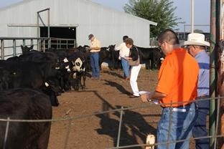
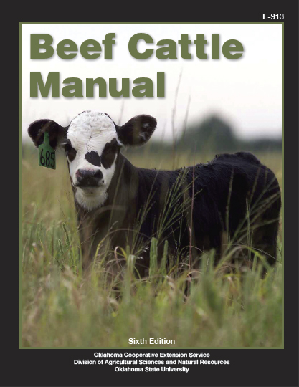

OSU Master Cattleman Program
www.agecon.okstate.edu/cattleman
The Master Cattleman Program was introduced in 2004 to enhance the profitability of beef operations and the quality of life of beef cattle producers by equipping them with vital information on all aspects of beef production, business planning, risk management and marketing.
Program Requirements
To be certified as a Master Cattleman, producers must complete a minimum of 28 hours of instruction from the Master Cattleman curriculum. The core curriculum consists of 4 hours from each of these disciplines:
Nutrition and management
Quality assurance and animal health
Reproduction (cow-calf producers)
Natural resources
Business planning and management
Marketing and risk management
WHAT DOES IT MEAN TO BE AN OSU MASTER CATTLEMAN?
The Oklahoma Master Cattleman has knowledge of sustainable practices in production, business management, marketing, herd health, and natural resources
Has successfully completed the curriculum for the Oklahoma Master Cattleman program
Has demonstrated comprehension as evidenced by passing quizzes associated with each area.
What does it cost?
The base cost of the program is $100.
What do I get for participating?
Information/education
Oklahoma Beef Cattle Manual
Master Cattleman farm gate sign
Master Cattleman certificate
Master Cattleman portfolio
Pistol Pete Ranch
Contact (Name) at (xxx) xxx-xxxx for details when the class will begin or to sign up.
Prepared by Oklahoma State University Cooperative Extension Service
Oklahoma State University, in compliance with Title VI and VII of the Civil Rights Act of 1964, Executive Order 11246 as amended, Title IX of the Education Amendments of 1972, Americans with Disabilities Act of 1990, and other federal laws and regulations, does not discriminate on the basis of race, color, national origin, gender, age, religion, disability, or status as a veteran in any of its policies, practices or procedures. This includes but is not limited to admissions, employment, financial aid, and educational services.

